Slide 1

DAPT-Oct23
FIFA Money Ball
AJAX TEAM
Sanober Khoso
Irina Markova
Jonatan Aguilera
Miguel Mendes

Slide 2

CONTENTS
1
Introduction
2
Analysis
3
Findings
4
Conclusion

Slide 3
INTRODUCTION
PART ONE
01
Currently, sports are heavily surrounded by data, both in terms of performance and business. We are going to seize this moment and these technologies to delve into the management of a team such as Ajax in order to make decisions that add value to the club..

Slide 4

01
INTRODUCTION
MAIN GOAL
We would like to analyze data for our team to find potential transfers and to acquire a young player with great potential at a good price.

Slide 5
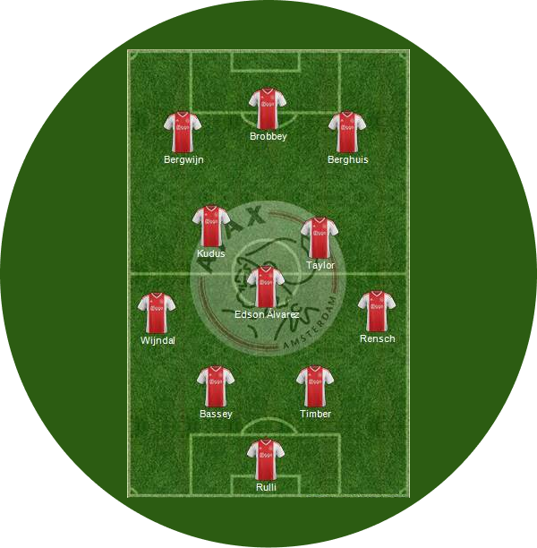
01
INTRODUCTION
OBJECTIVES
Find a way to select the best replacement.
Explore the data we have to identify potential relationships between variables.
Group the player types to better visualize important characteristics among them.
Examine if age correlates with the variables we've identified as important for our study.

Slide 6
ANALYSIS
PART TWO
02
We would like to analyze the different characteristics for players below 40 by grouping the different positions into more general categories of player types and see which skills they excel in.

Slide 7
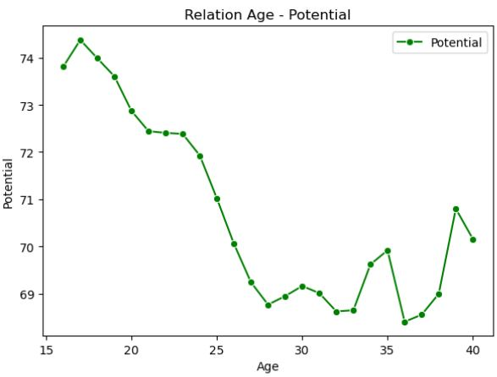
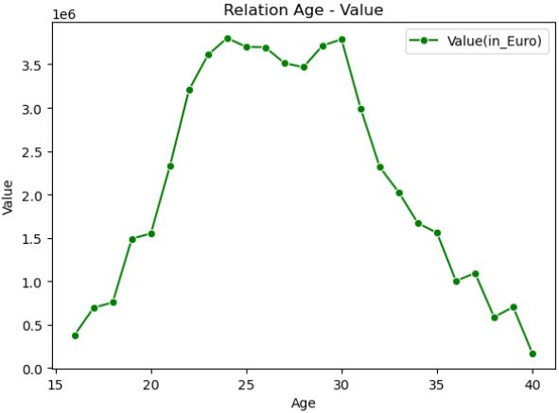
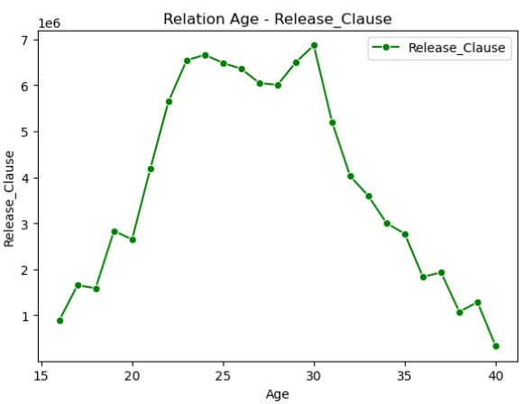
02
AGE RELATION ANALYSIS
POTENTIAL
VALUE
RELEASE CLAUSE
The trend is to have very high potential when you are young, from 16 to 20 years old, and it decreases once your value as a player consolidates.
The value grows significantly from the ages of 16 to 25, with a period of relative stability until the age of 30, at which point it plummets.
It has a low price until the age of 20 and experiences a significant increase until the age of 23 when it stabilizes until reaching the age of 30, at which point this price decreases.

Slide 8
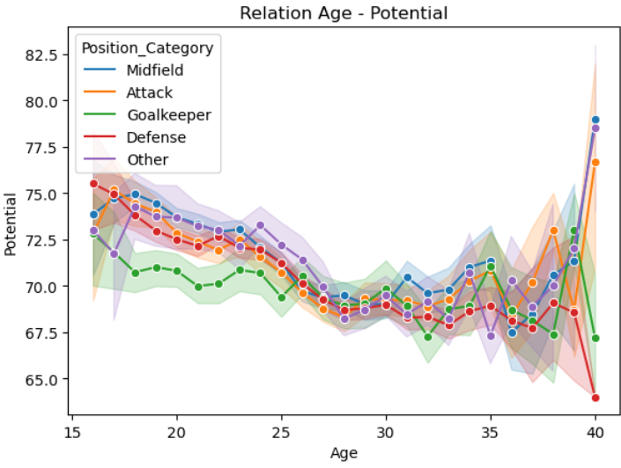
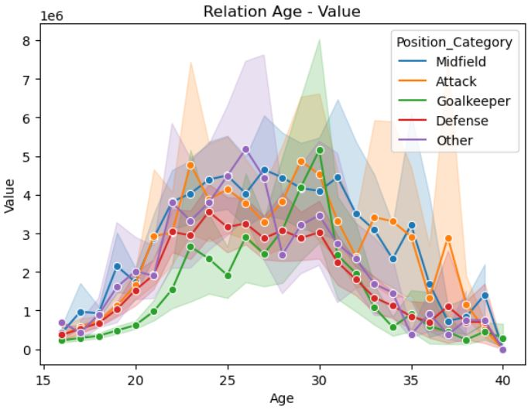
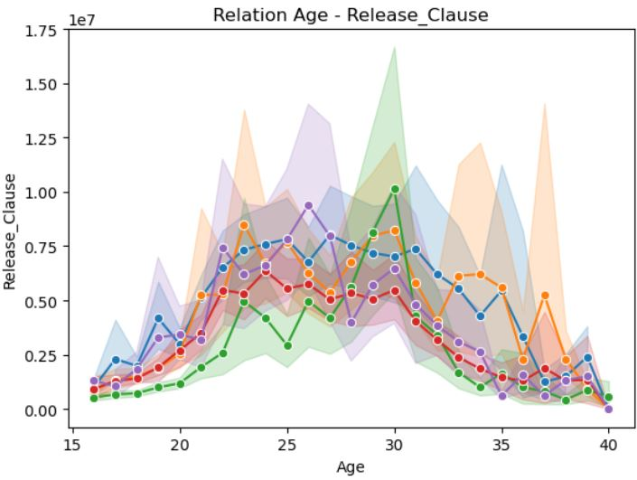
02
AGE RELATION ANALYSIS BY GROUP
POTENTIAL
VALUE
RELEASE CLAUSE
slightly lower than that of the others, especially at older ages
lower throughout the careers, except for goalkeepers
tends to be below other positions, but at the age of 30, it spikes and surpasses the average of the other positions.

Slide 9
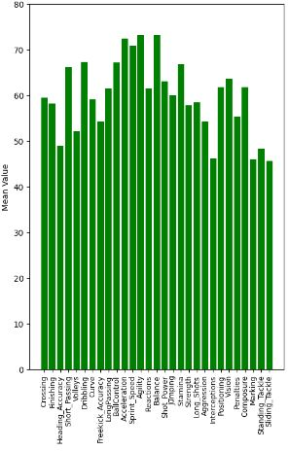
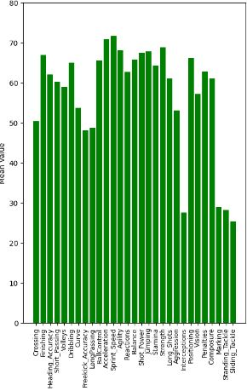
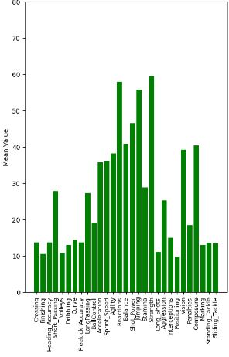
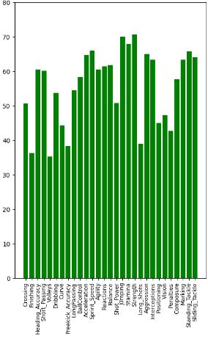
02
MAIN CHARACTERISTICS ANALYSIS
MIDFIELD
ATTACK
GOALKEEPER
DEFENCE

Slide 10
FINDINGS
PART THREE
03

Slide 11
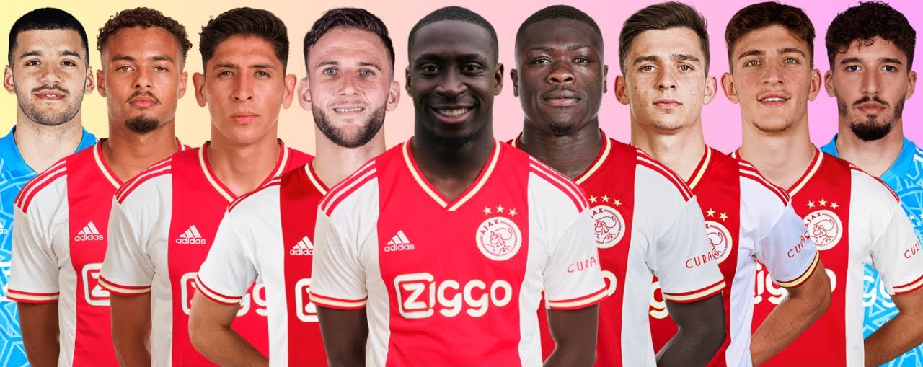
03
AJAX TEAM AVERAGE
Mean age: 23.6
Mean Overall: 74.4
Mean Value(in Euro): 13M

Slide 12
03
AJAX TEAM ANALYSIS
1
Big disparity of players that are best for certain positions. Many CAMs, CM /LW/RW only single players.
2
GK at the highest age group
3
There is a player in the team with double market value than others
4
Some players in CAM position are being paid way higher than others on the same position (or the rest of the team)

Slide 13
03
FINDINGS
Based on above data, our desired age limiting factor could be a goalkeeper that is between 17 to 22 years old. This will ensure we can have a talented defender which can be inside the team for the years to come, in case some of our players leave the teams or get the age of 30 year old.

Slide 14
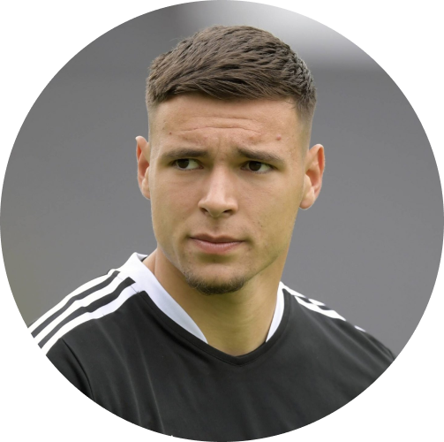

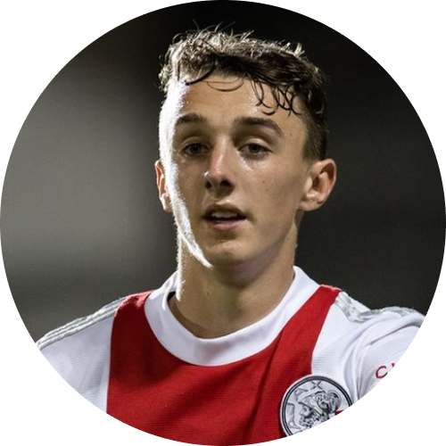
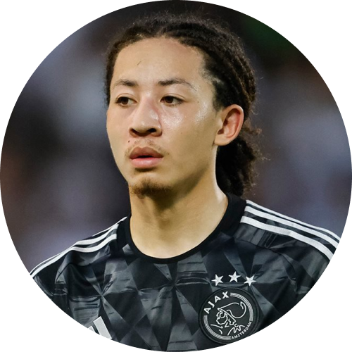
04
PLAYERS SOLD
J. GORTER
L. MAGALLÁN
5.800.000
2.200.000
Y. BAAS
K. FİTZ-JİM
1.800.000
3.000.000

Slide 15
03
FINDINGS
12.8
TOTAL ESTIMATED SALES
There was interest from other clubs in 4 players, and their release clauses were paid.
M

Slide 16
CONCLUSION
PART FOUR
04
For consideration:
good potential
young age
high GK rating
release clause under 12M

Slide 17
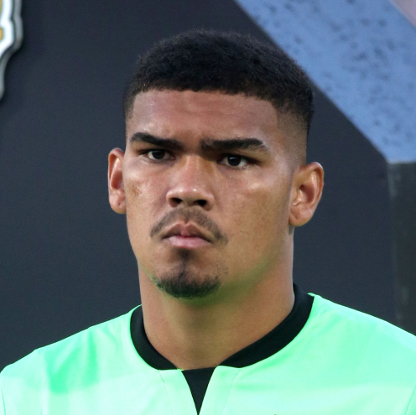
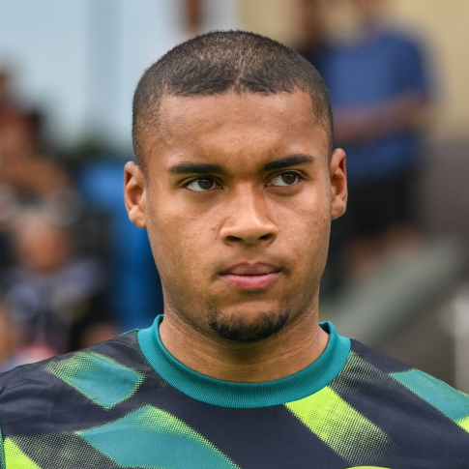
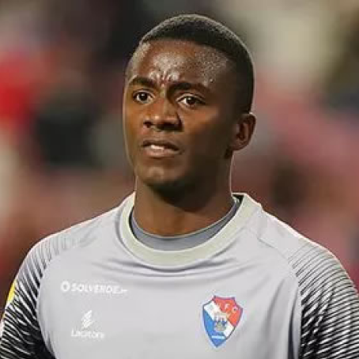
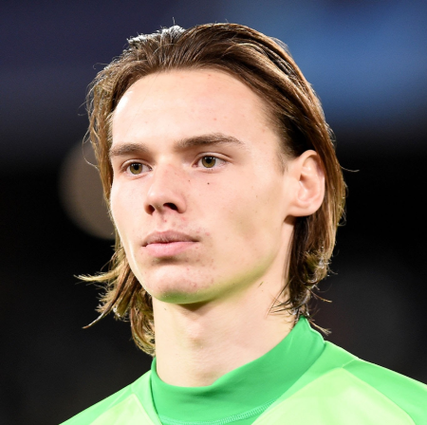
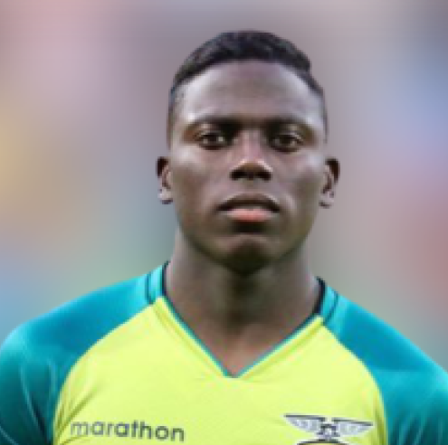
04
GK TO CONSIDER TO BUY
Luiz Júnior
Age: 21
GK Rating: 73
Potential: 82
Release Clause: 10.6m
Contract End: 2027
G. Bazunu
Age: 20
GK Rating: 71
Potential: 85
Release Clause: 8.6m
Contract End: 2027
M. Vandevoordt
Age: 20
GK Rating: 71
Potential: 82
Release Clause: 7.2m
Contract End: 2023
M. Ramírez
Age: 21
GK Rating: 73
Potential: 81
Release Clause: 7.4m
Contract End: 2023
Andrew
Age: 21
GK Rating: 71
Potential: 82
Release Clause: 7.8m
Contract End: 2024

Slide 18

04
CONCLUSION
CONCLUSION
M.Ramírez from Independiente del Valle or M. Vandevoort from KRC Genk are good options, as they have a good rating, huge potential, they are very young (20-21yo) and their contracts are ending this year. Their release clause is affordable in case we have to pay for them, and the wage very low.

Slide 19
DAPT-Oct23
THANK YOU !
Questions?
AJAX TEAM

